Slide 1

The Well-Dressed Bioinformatician
(NGS Computational Methods)

Slide 2
I got some sequence data. What now?

Slide 3
  File Formats
  Quality Control
  Sequence Alignment
  Motif Discovery
  De Novo Genome Assembly
  ChIP-seq
  RNA-seq

Slide 4
Some common file formats
FASTA
  Just the sequence, ma'am
FASTQ
  FASTA + “Quality” score for each base.
  Quality is ASCII (33 + Phred score)
@SEQ_ID
GATTTGGGGTTCAAAGCAGTATCGATCAAATAGTAAATCCATTTGTTCAACTCACAGTTT
+
!''*((((***+))%%%++)(%%%%).1***-+*''))**55CCF>>>>>>CCCCCCC65

Slide 5
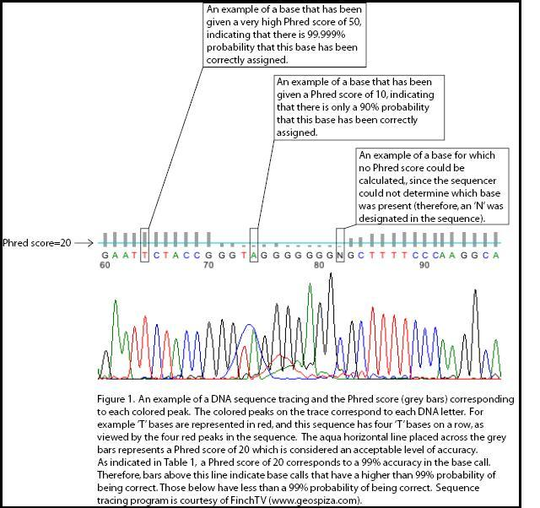

Slide 6
Phred scores
Q = Phred score
P = error probability

Slide 7
More file formats
SRA
  native format for Sequence Read Archive (repository of NGS data)
  Aligned sequences can be compressed by genome reference
  Convert to FASTQ with sra-toolkit (fastq-dump)

Slide 8
More file formats
SAM
  Sequence Alignment / Map
  generic format for aligned sequences
BAM
  binary version of SAM
  smaller
  most software wants this
Samtools
  Convert BAM to SAM
  Sort and index BAMs
  Count number of reads at a position (pileup)
  pysam: a python wrapper

Slide 9
More file formats
BED
  Discrete genome annotations (regions)
    Gene positions
    Exons / Introns
    Transcription start sites
    Protein binding sites
    Histone locations
    etc.
  Contains:
    Chromosome
    Start position
    Stop position
    Description fields
Bedtools
GFF and GTF are similar formats.
All are tab-separated, human-readable

Slide 10
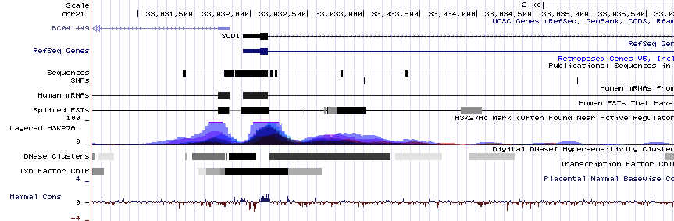
More file formats
wig and bigWig
  Wiggle tracks
  Continuous-valued genome annotations

Slide 11
  File Formats
  Quality Control
  Sequence Alignment
  Motif Discovery
  De Novo Genome Assembly
  ChIP-seq
  RNA-seq

Slide 12
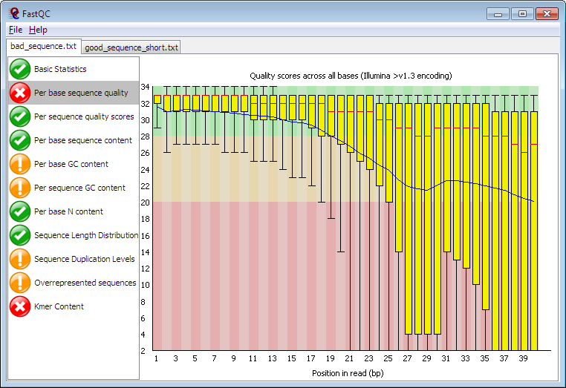
FASTQC
Graphical tool to evaluate NGS quality
Can be run in interactive or command line mode
Generates HTML reports
Evaluates results:
Note: Depending on your experiment, it may give false alarms

Slide 13
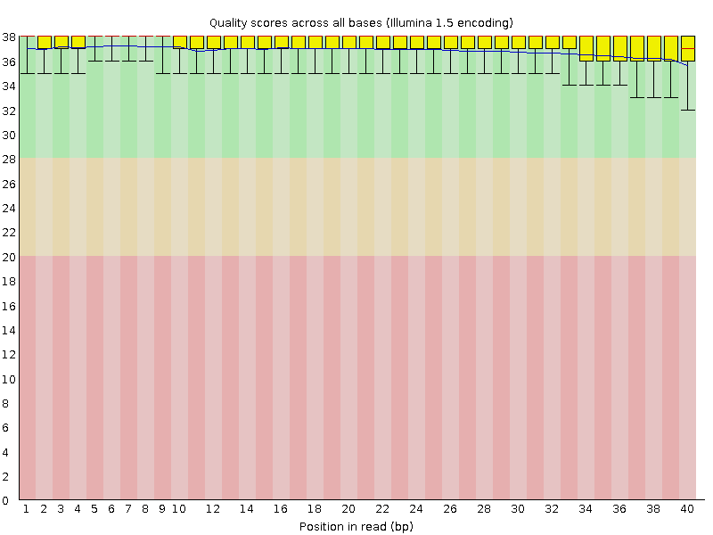
Per base sequence quality: good

Slide 14
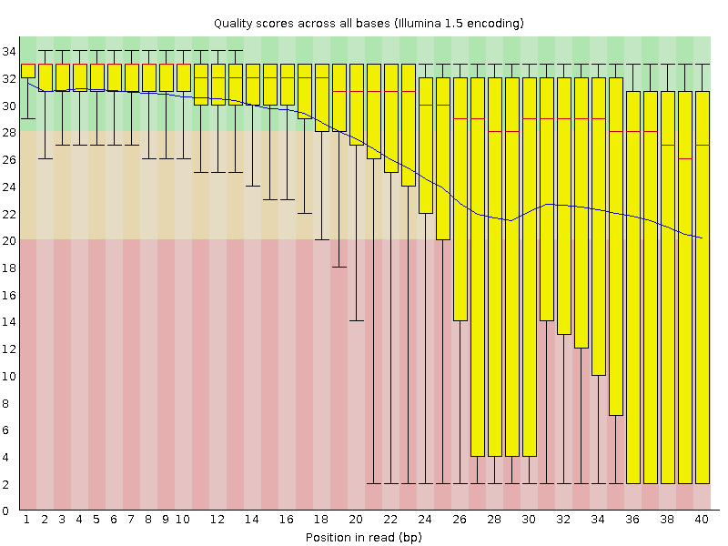
Per base sequence quality: bad

Slide 15
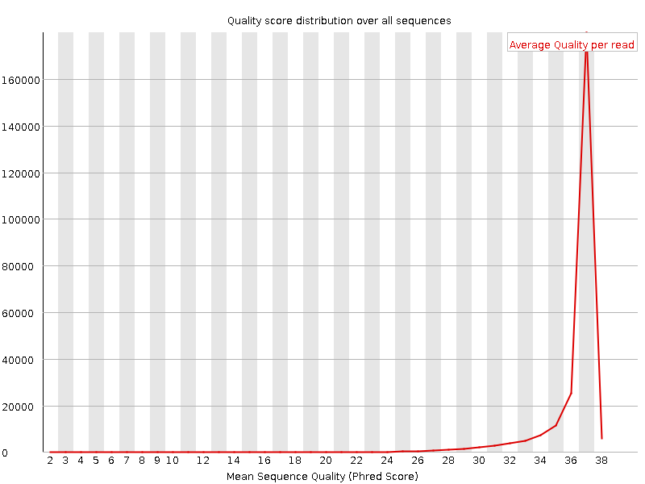
Per sequence quality scores: good

Slide 16
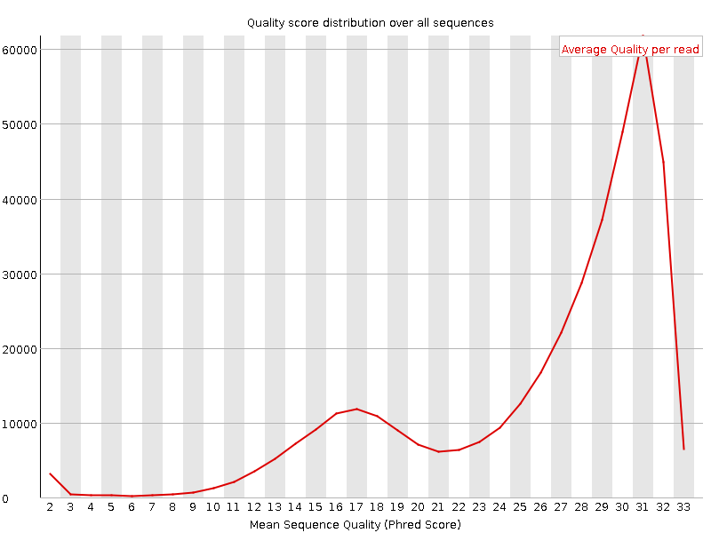
Per sequence quality scores: bad

Slide 17
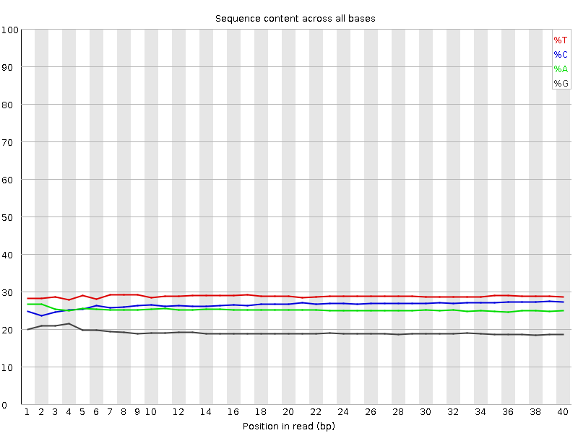
Per base sequence content: good

Slide 18
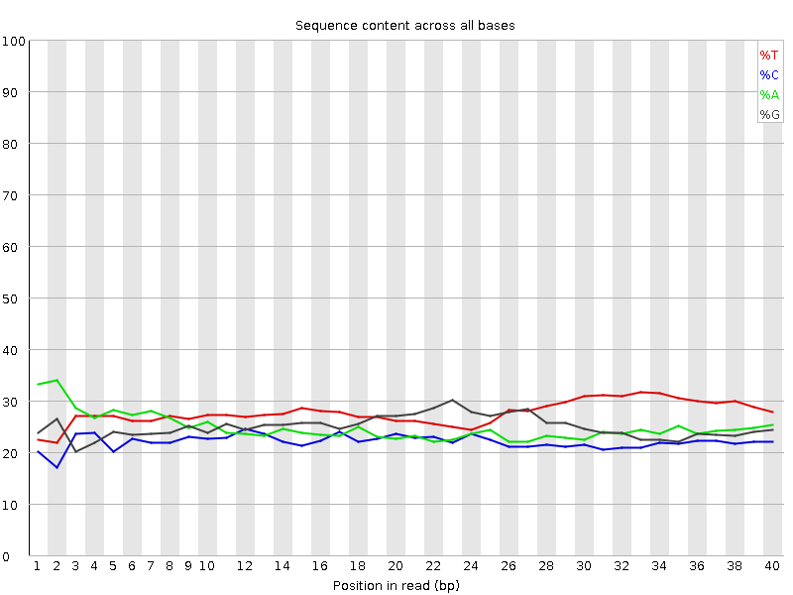
Per base sequence content: bad

Slide 19
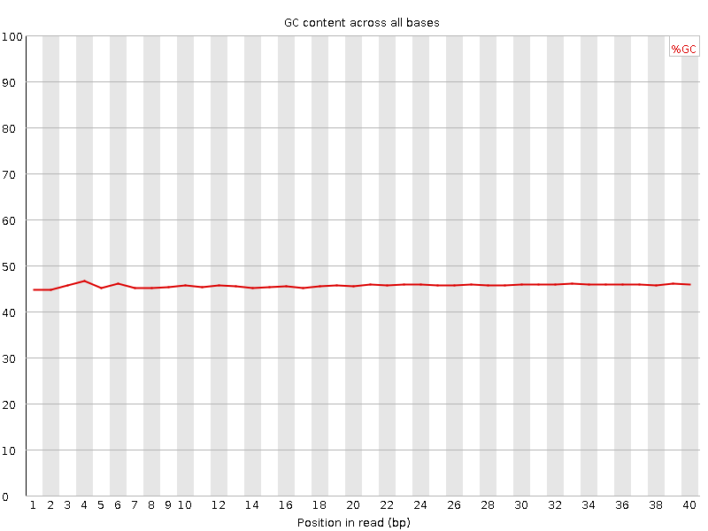
Per base GC content: good

Slide 20
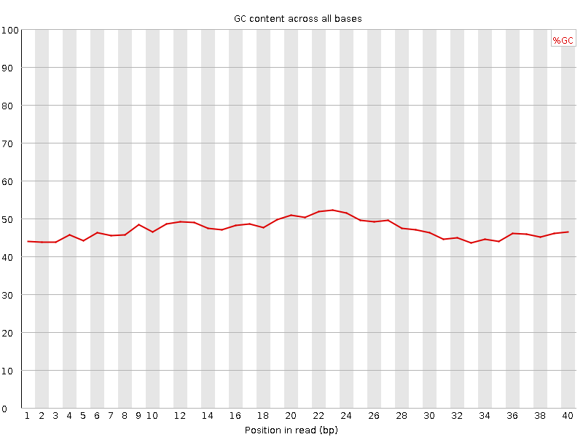
Per base GC content: bad

Slide 21
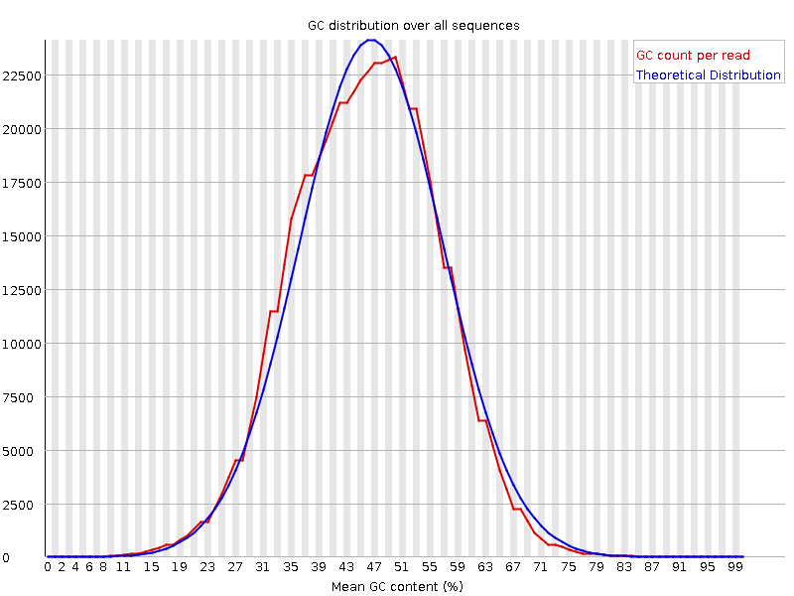
Per sequence GC content: good

Slide 22
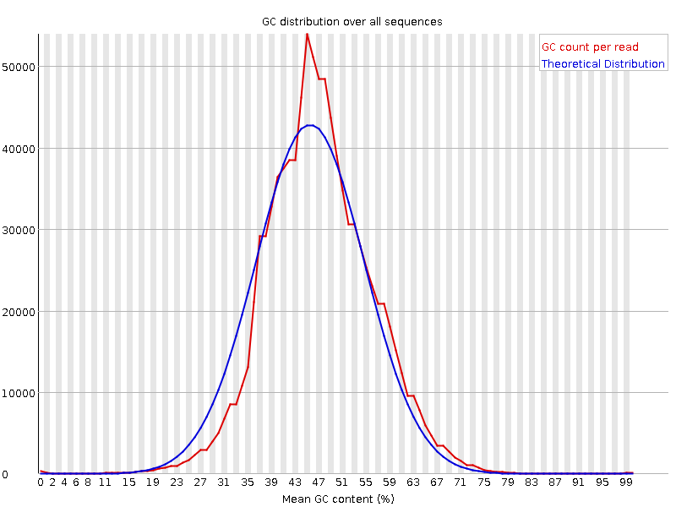
Per sequence GC content: bad

Slide 23
  File Formats
  Quality Control
  Sequence Alignment
  Motif Discovery
  De Novo Genome Assembly
  ChIP-seq
  RNA-seq

Slide 24
Sequence Alignment
Alignment with exact match
ABCTUV
ABUV
ABCTUV
AB--UV

Slide 25
Sequence Alignment
Inexact
ATTCCATTCATAA
ATTCTTAATAA
ATTCCATTCATAA
ATTC--TTAATAA

Slide 26
Sequence Alignment
Global alignment
CATGCTATGGTCA
ATGCGGTCGACAC
Local alignment
CATGCTATGGTCA
ATGC---GGTC

Slide 27
Pairwise Alignment Algorithms
Exact (returns optimal solution)
  Needleman – Wunsch (1970)
    Global
  Smith-Waterman (1981)
    Local
Heuristic (trade exactness for speed)
  FASTA (1985)
  BLAST (1990)
  MUMmer (1999)
  Vmatch
  Many more!

Slide 28
Multiple Alignment Algorithms
Optimal solution:
  O(length^{num_sequences})
Approximations:
  ClustalW, T-coffee
    Progressively combining pairwise alignments
  SAM, HMMER
    Hidden Markov models
  SAGA, RAGA
    Genetic algorithms
  MSASA
    Simulated annealing

Slide 29
Short Read Alignment
Some ways to improve performance:
  Compress and index the genome
    k-mer hashing
    Suffix trees
    Enhanced suffix arrays
    Burrows-Wheeler transform (BWT)
  Seed local alignments with exact matches

Slide 30

Short Read Alignment
BFAST
  Explicit time vs. accuracy tradeoff
  Handles indels
BWA
  Handles indels
Bowtie
  Doesn't handle indels
Bowtie2
  Handles indels
  Supports local alignment
  Handles paired end sequencing better

Slide 31
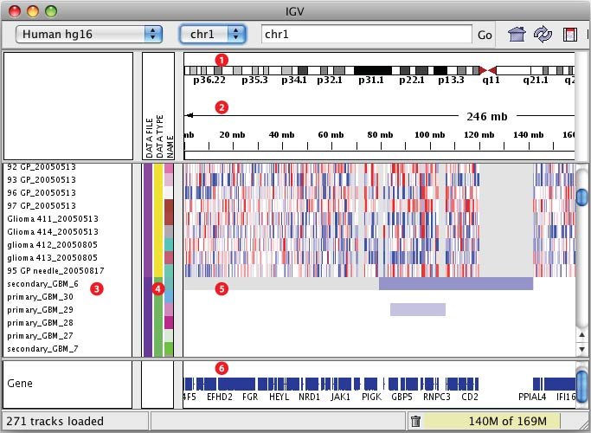
IGV

Slide 32
  File Formats
  Quality Control
  Sequence Alignment
  Motif Discovery
  De Novo Genome Assembly
  ChIP-seq
  RNA-seq

Slide 33
Motif discovery
Timothy L. Bailey and Charles Elkan, "Fitting a mixture model by expectation maximization to discover motifs in biopolymers", Proceedings of the Second International Conference on Intelligent Systems for Molecular Biology, pp. 28-36, AAAI Press, Menlo Park, California, 1994.

Slide 34

Motif discovery (de novo)
MEME
  Multiple Expectation Maximization for Motif Elicitation
  Bailey and Elkan (1995)

Slide 35

Motif discovery (de novo)
HOMER
  Hypergeometric Optimization of Motif EnRichment
  Motif analysis & more!
  Chris Brenner (Glass lab)

Slide 36
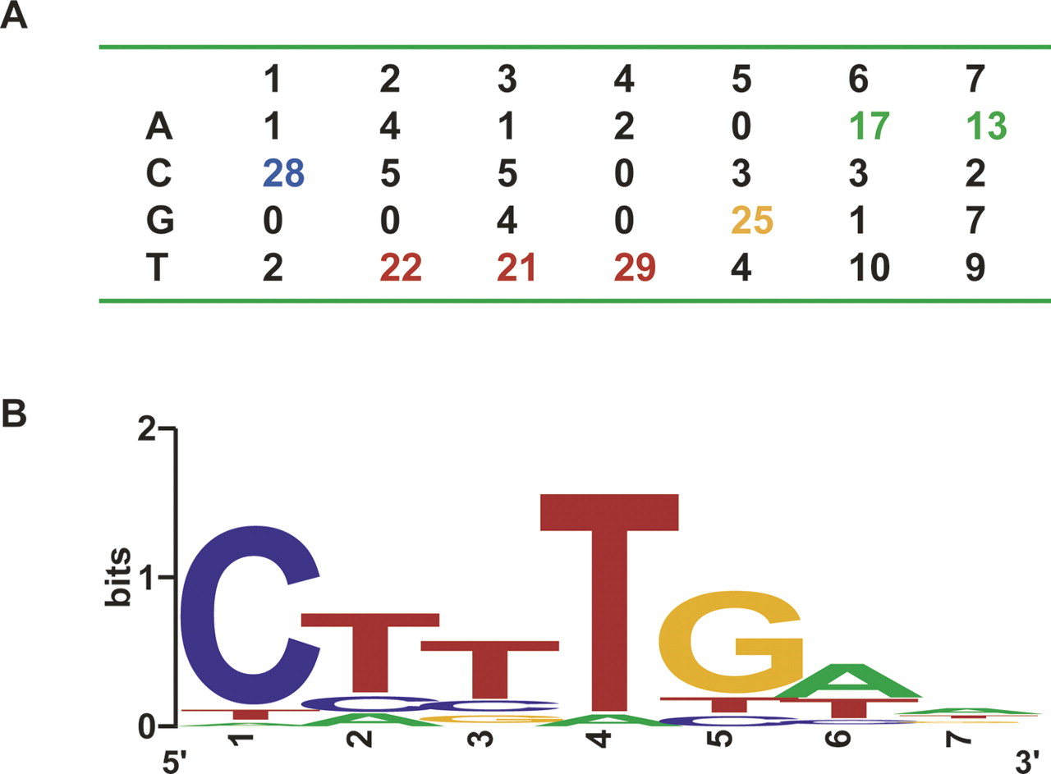
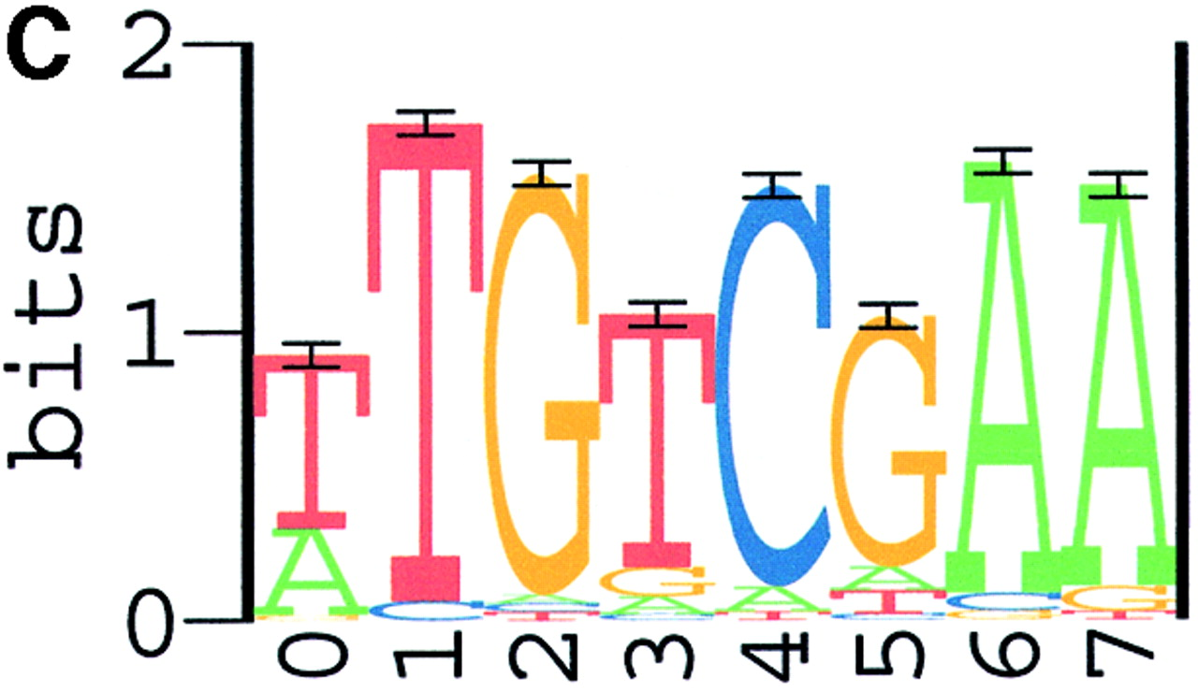
Sequence Logo

Slide 37
  File Formats
  Quality Control
  Sequence Alignment
  Motif Discovery
  De Novo Genome Assembly
  ChIP-seq
  RNA-seq

Slide 38
De novo genome assembly
Traditionally done with Sanger sequencing
  Long reads ~1000s of bp
  Tools (overlap-layout-consensus)
    Atlas
    ARACHNE
    Celera
    PCAP
    phrap
    Phusion

Slide 39
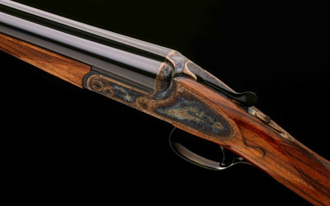
De novo genome assembly
Overlap-layout-consensus approach
  Does OK with small numbers of long reads
  poorly suited to millions of short NGS reads
    10s to 100s of bp
  Doesn't handle repeats well – so generally just ignores them

Slide 40
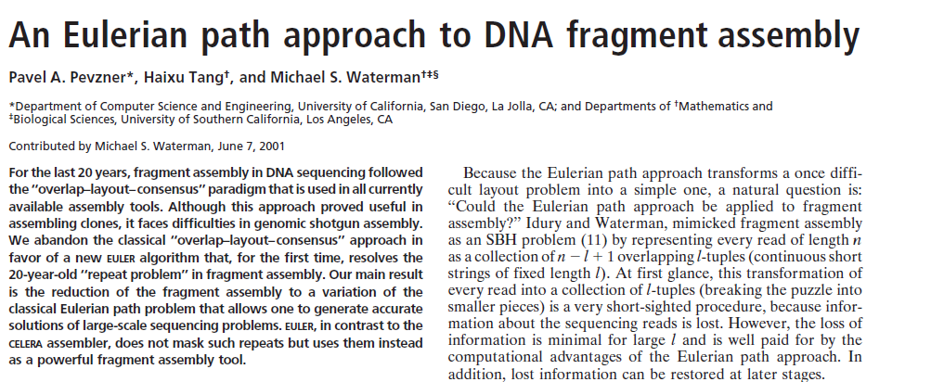

Slide 41
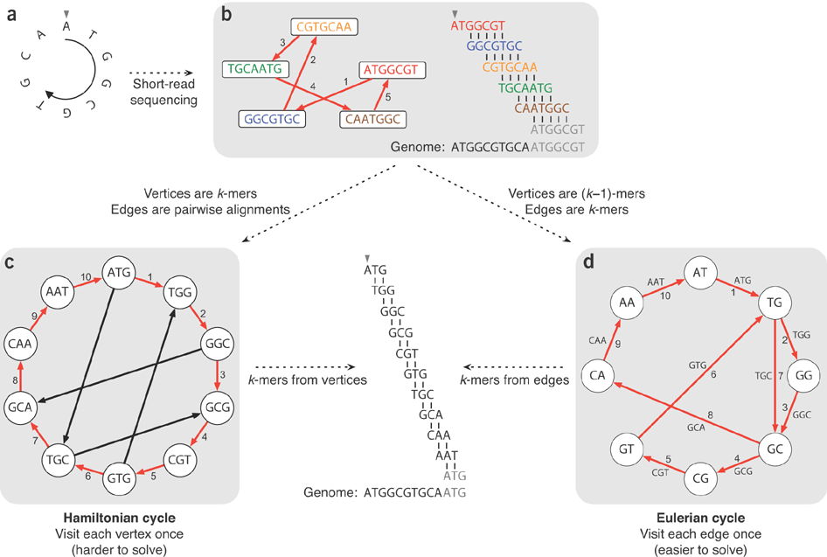
Compeau, P.E.C., Pevzner, P.A., and Tesler, G. (2011). How to apply de Bruijn graphs to genome assembly. Nature Biotechnology 29, 987–991.
Notes:
(a) An example small circular genome. (b) In traditional Sanger sequencing algorithms, reads were represented as nodes in a graph, and edges represented alignments between reads. Walking along a Hamiltonian cycle by following the edges in numerical order allows one to reconstruct the circular genome by combining alignments between successive reads. At the end of the cycle, the sequence wraps around to the start of the genome. The repeated part of the sequence is grayed out in the alignment diagram. (c) An alternative assembly technique first splits reads into all possible k-mers: with k = 3, ATGGCGT comprises ATG, TGG, GGC, GCG and CGT. Following a Hamiltonian cycle (indicated by red edges) allows one to reconstruct the genome by forming an alignment in which each successive k-mer (from successive nodes) is shifted by one position. This procedure recovers the genome but does not scale well to large graphs. (d) Modern short-read assembly algorithms construct a de Bruijn graph by representing all k-mer prefixes and suffixes as nodes and then drawing edges that represent k-mers having a particular prefix and suffix. For example, the k-mer edge ATG has prefix AT and suffix TG. Finding an Eulerian cycle allows one to reconstruct the genome by forming an alignment in which each successive k-mer (from successive edges) is shifted by one position. This generates the same cyclic genome sequence without performing the computationally expensive task of finding a Hamiltonian cycle.

Slide 42

Velvet
velveth
  Creates hashtable for velvetg
  May want to play with k-mer length (hash length)
velvetg
  Assembles using de Bruijn graphs
VelvetOptimizer
  optimizes parameters

Slide 43
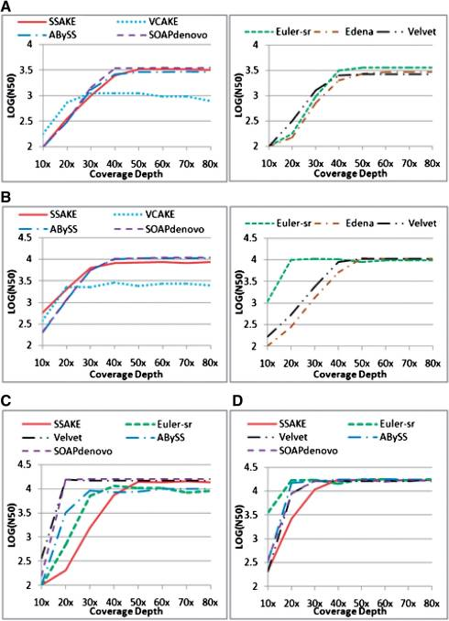
Comparison of the effect of various coverage depths on N50 length in T.bru assembly when BCER was 0.6%. (A) Single-end reads assembly, read length (RL)=35 bp; (B) single-end assembly, RL=75 bp; (C) paired-end reads assembly, RL=35 bp; (D) paired-end assembly, RL=75 bp.
Lin, Y., Li, J., Shen, H., Zhang, L., Papasian, C.J., and Deng, H.-W. (2011). Comparative studies of de novo assembly tools for next-generation sequencing technologies. Bioinformatics 27, 2031–2037.

Slide 44
  File Formats
  Quality Control
  Sequence Alignment
  Motif Discovery
  De Novo Genome Assembly
  ChIP-seq
  RNA-seq

Slide 45
ChIP-seq data analysis
NGS reads
1
NGS reads
2
Map uniquely to genome
Map uniquely to genome
Remove duplicates (optional)
Remove duplicates (optional)
Call peaks
Call peaks
Use IDR to determine rank cutoff
Threshold peaks
Threshold peaks

Slide 46
Duplicate removal
PCR amplification step produces multiple copies of same fragment
  sequence composition, size, etc. biases distribution
  shows up as multiple reads with same 5' position
However, expect some proportion of “real” duplicate reads based on coverage
Benefits of removal for various applications debated but most favor removal

Slide 47
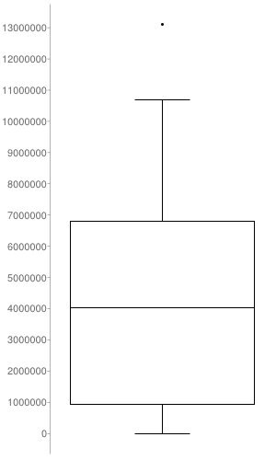
Duplicate removal
S. cerevisiae genome = 12.5 x 10⁶ bp
Mean dataset size = 4 x 10⁶ uniquely mapped reads
Box plot of reads per IP replicate in S. cerevisiae data

Slide 48
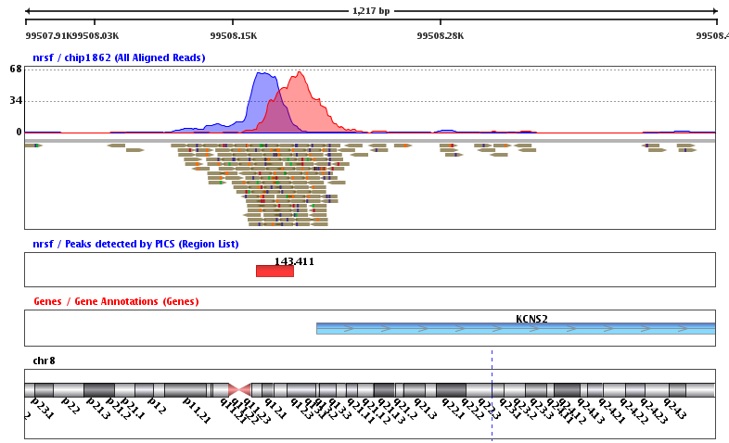
Peak Calling

Slide 49
Peak Calling
Large (40+) and expanding panoply of algorithms
“It is challenging to rigorously assess subtle improvements due to the scarcity and unreliability of verified binding sites for any ChIP-seq dataset.”
  Wilbanks and Facciotti (2010)

Slide 50
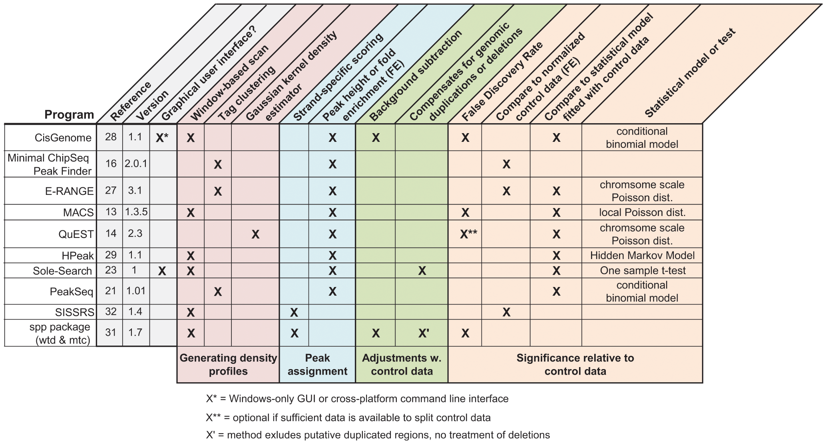

ChIP-seq peak calling programs selected for evaluation in Wilbanks and Facciotti (2010)
Wilbanks EG, Facciotti MT (2010) Evaluation of Algorithm Performance in ChIP-Seq Peak Detection. PLoS ONE 5(7): e11471. doi:10.1371/journal.pone.0011471
http://www.plosone.org/article/info:doi/10.1371/journal.pone.0011471

Slide 51
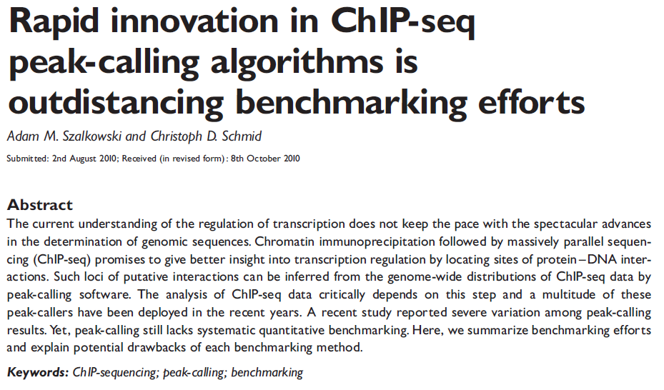
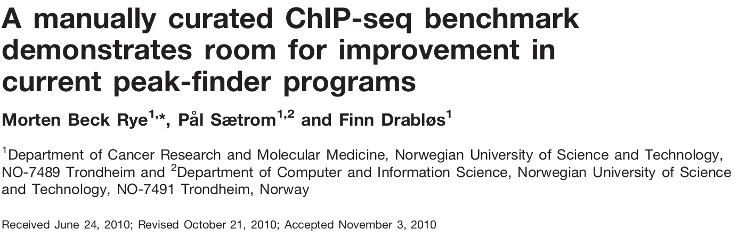

Slide 52
The MACS methodology initially identifies a set of high-confidence peaks which exhibit between 20-100 fold enrichment in reads and then uses these to model the average distance between reads on the two DNA strands.
It then uses a binomial distribution to remove duplicate tags which are represented at statistically unlikely levels within the sample.
Next it generates a full set of candidate peaks by comparing the enrichment within windows to a Poisson distribution generated from the control (input DNA or mock IP)

Slide 53
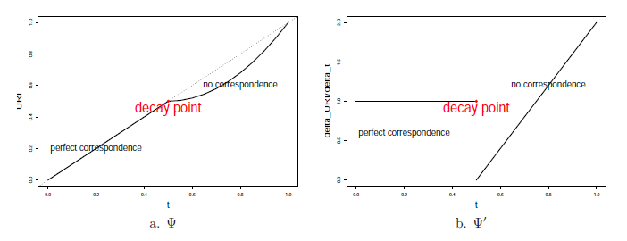
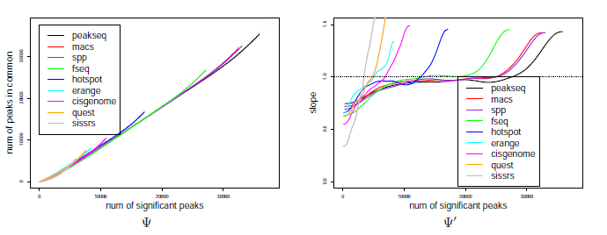
Irreproducible discovery rate (IDR)
Li, Q., Brown, J.B., Huang, H., and Bickel, P.J. (2011). Measuring reproducibility of high-throughput experiments. The Annals of Applied Statistics 5, 1752–1779.

Slide 54
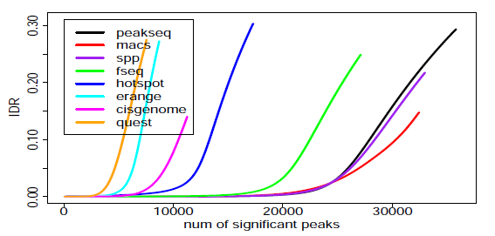
Irreproducible discovery rate (IDR)

Slide 55
  File Formats
  Quality Control
  Sequence Alignment
  Motif Discovery
  De Novo Genome Assembly
  ChIP-seq
  RNA-seq

Slide 56
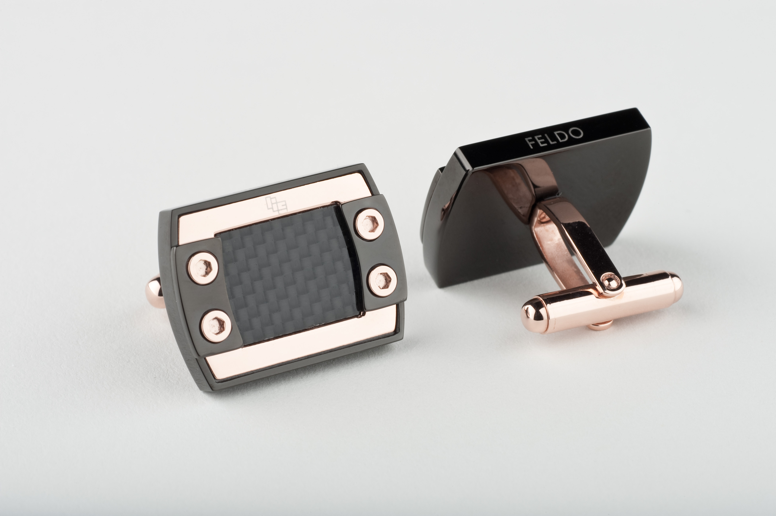
RNA-seq
Cufflinks
  Analyze transcriptomes (at least 2 conditions) for differential expression & significance

Slide 57

RNA-seq
CummeRbund
  R package
  Visualizing results from cuffdiff
  Create SQLite database of results & relationships

Slide 58

RNA-seq
TopHat
  Uses BowTie to map reads to genome
  Analyzes mapping for evidence of splice junctions
  Huge diversity of splice isoforms in higher eukaryotes

Slide 59


